Slide 1
Industrial Revolutions

Slide 2
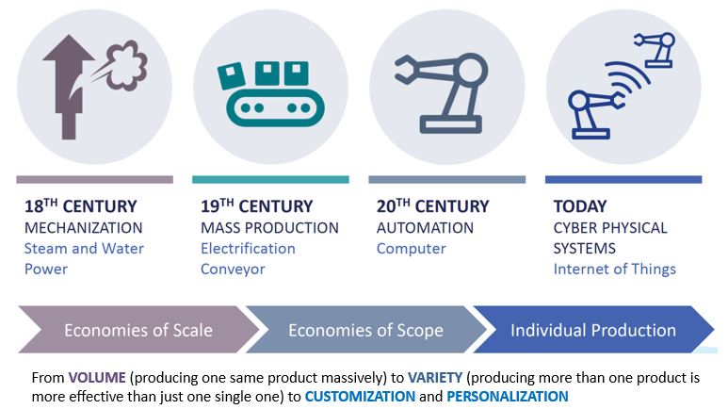
A Brief History of the Industrial Revolutions
Notes:
It is generally accepted that there have been four industrial revolutions, but that these revolutions have not taken place simultaneously in all countries. There are even developing countries where the second or the third industrial revolution has not yet occurred.

Slide 3
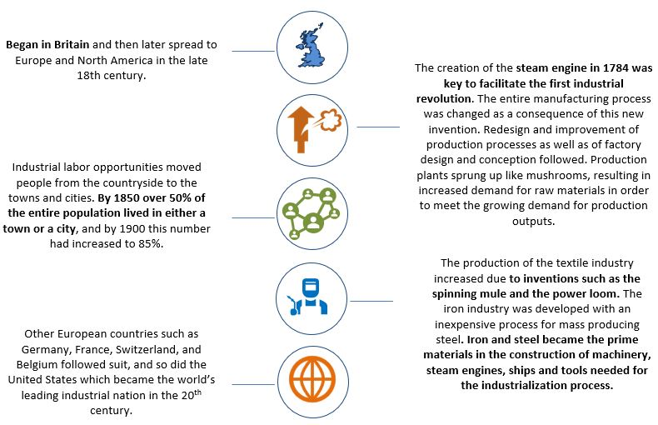
The 1st Industrial Revolution
Notes:
It was triggered by water and steam power, which enabled increasingly mechanized production processes and the reduction of human labor inputs needed per output created.

Slide 4
Positive Impacts
Increased productivity: Technological advancements led to increased production efficiency and output.
Economic growth: The Industrial Revolution fuelled economic growth, creating new industries and jobs.
Improved living standards: Mass production made goods more affordable, leading to improved living standards for some.
Technological advancements: The development of new technologies, such as the steam engine and the spinning jenny, transformed society.
Urbanization: The growth of cities led to increased cultural exchange and economic opportunities.

Slide 5
Negative Impacts
Poor working conditions: Factory workers often faced long hours, low wages, and dangerous working conditions.
Child labour: Children were frequently employed in factories, often under hazardous conditions.
Urbanization problems: Rapid urbanization led to overcrowding, pollution, and social problems.
Environmental damage: Industrial activities caused significant environmental pollution and resource depletion.
Social inequality: The gap between the wealthy and the poor widened, leading to social unrest.

Slide 6
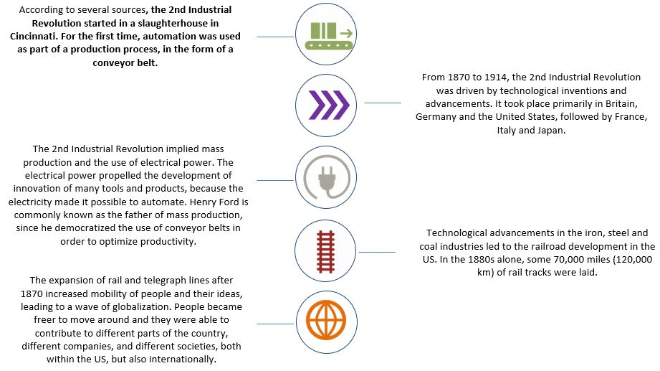
The 2nd Industrial Revolution
Notes:
Was driven by electrical power to create mass production.

Slide 7
Impacts
Technological advancements: The Second Industrial Revolution was a period of rapid technological advancement, leading to innovations in fields like chemistry, physics, and engineering.
New industries: The development of new technologies led to the creation of new industries, such as the automobile industry and the electrical industry.
Globalization: Advances in transportation and communication facilitated the globalization of trade and culture.
Resource depletion: The demand for resources to fuel industrial growth led to the depletion of natural resources.

Slide 8
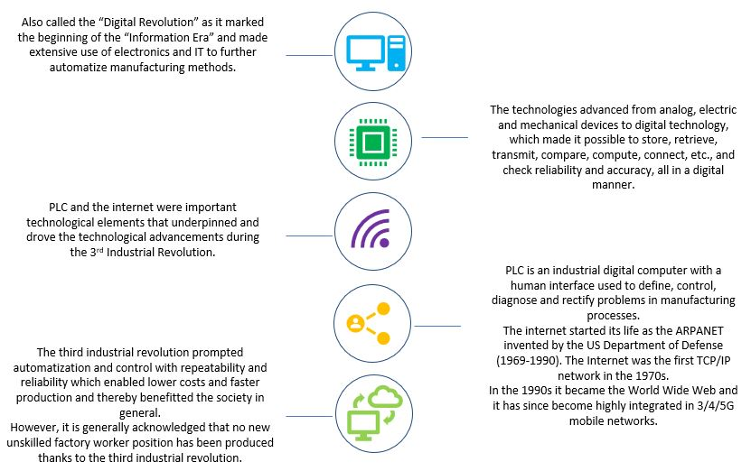
The 3rd Industrial Revolution
Notes:
Used electronics and IT to automate manufacturing.

Slide 9
Positive Impacts
Economic growth: The development of new industries, such as information technology, biotechnology, and e-commerce, has driven economic growth.
Improved access to information: The internet has made information more accessible to people around the world.
Increased connectivity: Digital technologies have increased connectivity between people and organizations.
Advances in healthcare: Digital technologies have enabled advancements in healthcare, such as telemedicine and personalized medicine.
Improved education: The internet has made education more accessible and affordable.

Slide 10
Negative Impacts
Job displacement: Automation and other technological advancements have led to job displacement in some industries.
Digital divide: Not everyone has access to digital technologies, which can create a digital divide.
Privacy concerns: The collection and use of personal data by corporations and governments has raised privacy concerns.
Cybersecurity threats: The increasing reliance on digital technologies has also increased the risk of cyberattacks.
Environmental impact: The production and use of digital technologies can have a negative impact on the environment.

Slide 11
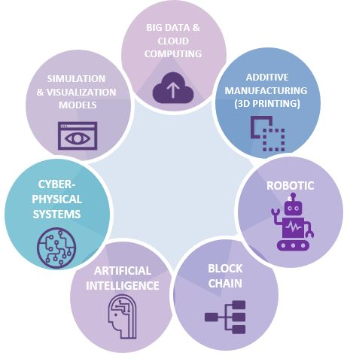
The 4th Industrial Revolution
Notes:
The Fourth Industrial Revolution is not driven only by the invention of various new technologies, but it is also based on advances in communication and connectivity , and it is also marked by emerging technology breakthroughs in a number of fields.

Slide 12
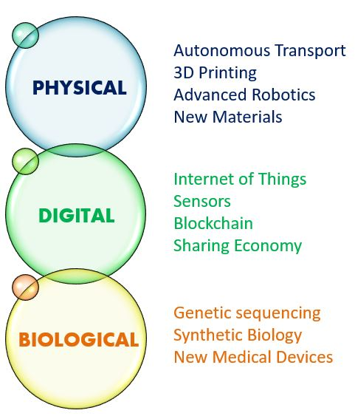
Megatrends of the 4th Industrial Revolution

Slide 13
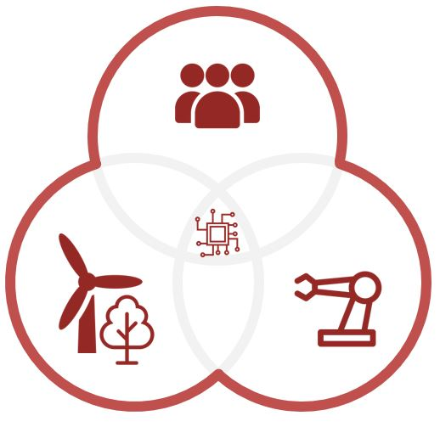
People, Technology and Resources

Slide 14
“Industry 4.0” and the “4th Industrial Revolution” ???
Notes:
Industry 4.0 represents the economic point of view, focusing on industry, manufacturing / production and technology.
The 4th Industrial Revolution describes a technologically driven paradigm change that affects all spheres of life.

Slide 15
Industry 5.0
We are now entering the fifth industrial revolution with a focus on man and machines working together.
Industry 5.0 can be seen as complementing the advances made in Industry 4.0 to support rather than supersede humans.
while Industry 4.0 was technology-driven Industry 5.0 is value-driven. Where 4.0 looked to automation and the increased focus on technology, 5.0 bring humanity back into the field, combining with technology to provide systems and processes that serve people and the world around us first.
Notes:
https://www.twi-global.com/technical-knowledge/faqs/industry-5-0

Slide 16
Industry 4.0 vs Industry 5.0
Features | Industry 4.0 | Industry 5.0
Focus | Automation and technology for efficiency improvement in manufacturing and production | Creation of sustainable, environmentally friendly manufacturing processes
Emphasis | Use of data and analytics to optimize processes | Importance of human interaction and collaboration
Competencies | IoT, AI, ML for task and decision automation | Combination of advanced technologies with human skills and creativity
Use | Robots and autonomous machines for repetitive, hazardous, or precision tasks | Development of new skills and competencies among human workers
Factories | Smart factories for self-optimization of production processes | Integrated, flexible production system for adaptation to customer requirements and market trends
Technologies | Digital twins and simulation tools for production process optimization | Advanced technologies such as nanotechnology and biotechnology for creating new materials and products
Efficiency | Predictive maintenance, remote monitoring, and real-time data analysis for efficiency improvement and cost reduction | Prioritization of sustainability and ethical production practices to minimize waste and reduce environmental impact

Slide 17
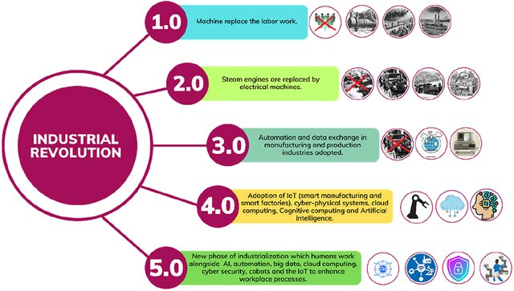
The Changes?
Notes:
A collaborative robot, also known as a cobot, is an industrial robot that can safely operate alongside humans in a shared workspace.

